Slide 1

18CSE392T – Machine Learning I
Department of Data Science and Business Systems

Slide 2
UNSUPERVISED LEARNING

Slide 3
Unsupervised Learning
Un labelled data
No guidance
Relatively co-occur
1
2
3

Slide 4
Definition
Unsupervised ML is a method in which the machine is trained on unlabelled data without any guidance.
In other words.....
For just given output data, without any inputs. The goal is to discover “interesting structure” in the data; this is sometimes called knowledge discovery.

Slide 5
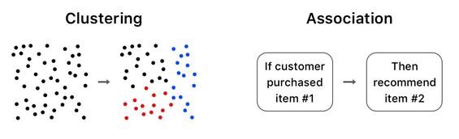
Categories
Clustering
Grouping based on similarity
Association
Discovering patterns in data

Slide 6
Association
Association rules allow you to establish associations amongst data objects inside large databases.
This unsupervised technique is about discovering interesting relationships between variables in large databases.
For example, people that buy a new home most likely to buy new furniture.

Slide 7
Clustering
Clustering: is the assignment of a set of observations into subsets (called clusters) so that observations in the same cluster are similar in some sense.
Clustering is a method of unsupervised learning, and a common technique for statistical data analysis used in many fields.

Slide 8
Data
Unlabelled Input Data
Patten Output Data (grouping)

Slide 9
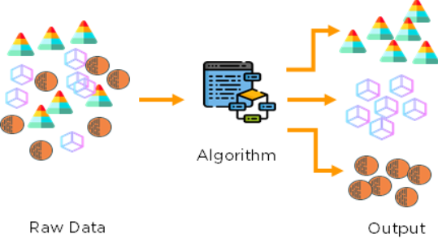
Unsupervision of Training
Needs NO External Supervision from training data

Slide 10
Applications (Supervised learning)

Slide 11
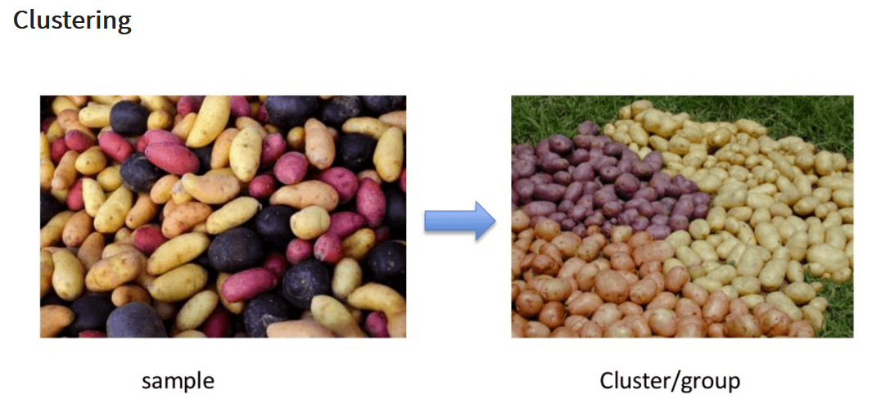
Vegetable clustering

Slide 12
Identifying fraudulent or criminal activity
In this scenario, we are going to focus on fraudulent taxi driver behavior.
What is the problem: You need to look into fraudulent driving activity. The challenge is how do you identify what is true and which is false?
How clustering works: By analysing the GPS logs, the algorithm is able to group similar behaviors. Based on the characteristics of the groups you are then able to classify them into those that are real and which are fraudulent.

Slide 13
Algorithms
K – means
C- means
Apriori algorithm

Slide 14


